Slide 1
Welcome to
Research paper about Text Classification

Slide 2
Presented by
Al Amin CSE2102023107
Tuhin Alam CSE2102023013
Md. Wahidul Islam CSE1903018021
Maraj Hossain Fahim CSE1903018095
Under the supervision of, Md. Rashedul Islam
Lecturer, Department of Computer Science and Engineering Sonargaon University

Slide 3
Objective
Text classification
Organized text
Enhance reader experience
Time saving
Digitalized the world

Slide 4
Types
Supervised
This algorithm is trained on labeled data.
Trained from given data
Unsupervised Learning
This algorithm is used to identify patterns in data without labels..
Reinforcement Learning
In this algorithm learns by interacting with the environment and receiving feedback in the form of rewards or penalties.

Slide 5
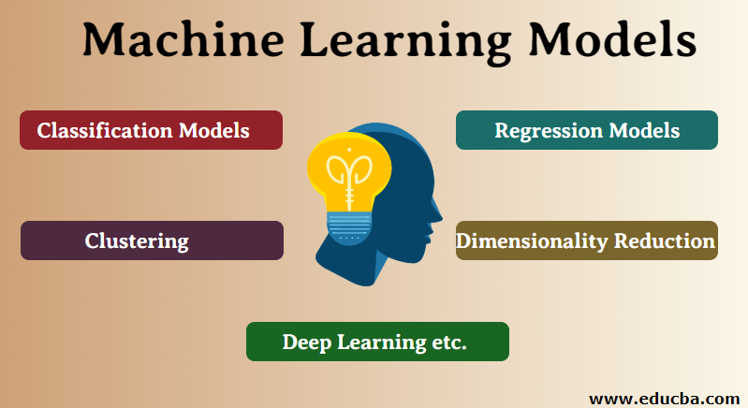
Diagram

Slide 6
Key Concepts:
Data collection
Text preprocessing
Feature extraction
Dimensionality reduction
Classification techniques
Performance evaluation

Slide 7
Algorithms
Linear Regression:
Used for predicting continuous values.
Decision Trees:
Used for classification and regression tasks.
Support Vector Machines (SVM):
Used for classification tasks.
Neural Networks:
Used for complex tasks like image and speech recognition.

Slide 8
Applications
Document Clustering:
Organizing large corpora
Topic Discovery:
Identifying themes in news articles, social media, etc.
Information Retrieval:
Enhancing search engines

Slide 9
Advantage
Enhanced Predictive Accuracy
Robustness and Adaptability
Reduced Over fitting
Scalability.
Computational Efficiency
Versatility
Innovative Design

Slide 10
Limitations
Performance: It can not provide output without learn machine.
Data set: Need big data set for training machine.
Complexity of Implementation
Computational Resource Demand
Scalability Challenges
Domain-Specific Fine-Tuning

Slide 11
Future work
Algorithm Optimization
Less data set requires
Robustness to Diverse Data Types
Scalability Improvements
Integration with Real-Time Systems

Slide 12
Conclusion
Unsupervised techniques are crucial for text classification without labeled data. Significant reduction in manual effort and scalability for large datasets. Continuous improvement in methods and applications.

Slide 13
References
[1707.02919] A Brief Survey of Text Mining: Classification, Clustering and Extraction Techniques (arxiv.org)
Machine learning paper.pdf

Slide 14
Thank you

